Slide 1

CAPSTONE PROJECT RESEARCH

Slide 2
KNOWING THE COMPONENTS OF CHAPTER 4

Slide 3

Project Model Project Mechanism/Source Code Project Manual Project Cost
Components of chapter 4

Slide 4
Project Model

Slide 5

What to put in the project model?
The project design is also the blueprint of the product. It must be in this section that the developers carefully discuss the materials being used and also the system essential for the construction of the project. In addition, the special features of the product must be stipulated in this part.
Before making the abovementioned things, the developers must be equipped with enough knowledge and skills for the designing, development, and innovation of the project.
These are some of the suggested program or seminar-workshop that the students may adhere, basically the seminar-workshop target for this would be at least three (3) to seven (7) days per major topic:

Slide 6
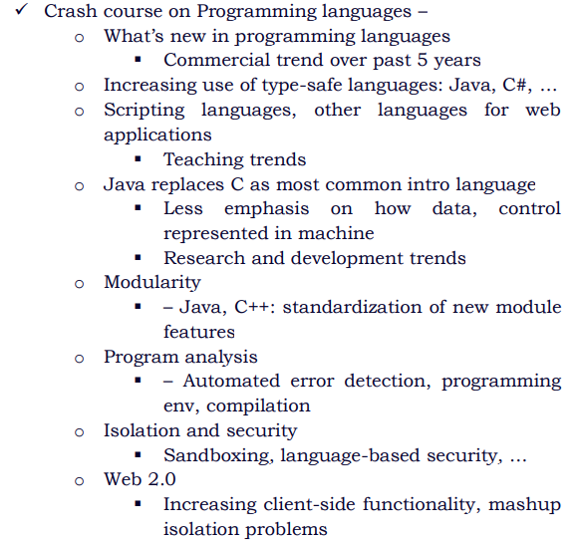
What to put in the project model?

Slide 7
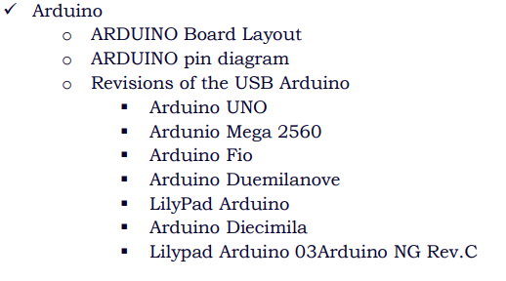

What to put in the project model?

Slide 8
What to put in the project model?
Important note:
Face to Face Guidelines: When the developers are now ready to construct their project, they have the option to or not to coordinate with an expert for the development and innovation of their study.
Important note:
Online Guidelines: When the developers are now ready to construct their project, they have to coordinate with an expert (related on the study) for the development and innovation of their study.

Slide 9
What to put in the project model?
Components of Project Model (for Machine Based):
Blueprint of the Project
Front view
Top view
Right side view (optional)
Product Details
Weight
Dimensions
Others: (Speed Control, Battery Life, Safety Features)
Complete Specifications
Complete Components
Capacity
Power rating
Current, Voltage,RPM

Slide 10
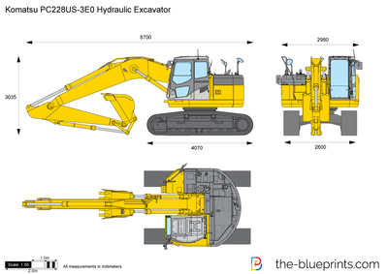
What to put in the project model?
Components of Project Model (for Machine Based):
Blueprint of the Project (2D or 3D)
Some Application:
AutoCad
AutoDesk Build
2D and 3D CAD
Sketch Up
Siemens NX CAD
Technical Drawing

Slide 11
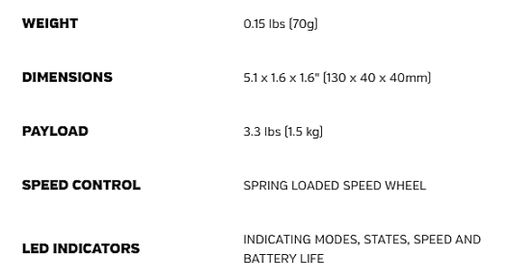
What to put in the project model?
Components of Project Model (for Machine Based):
Product Details

Slide 12
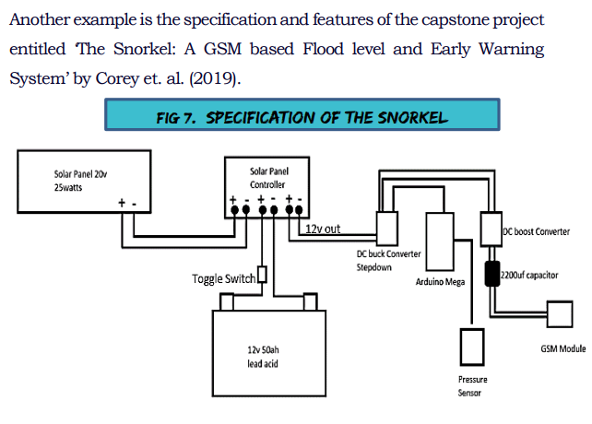
What to put in the project model?
Components of Project Model (for Machine Based):
Complete Specifications

Slide 13
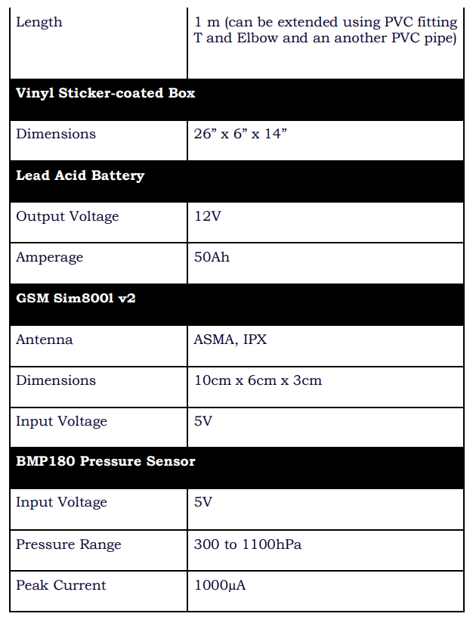
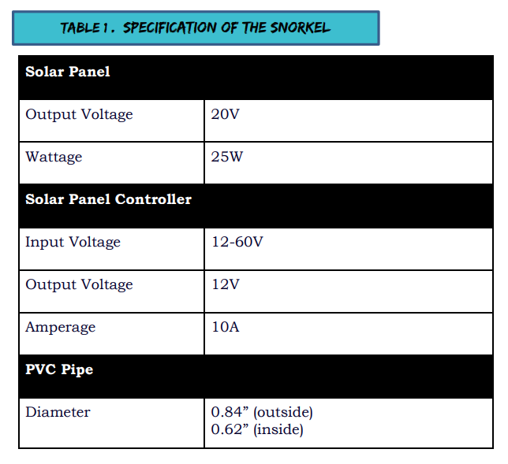
What to put in the project model?
Components of Project Model (for Machine Based):
Complete Specifications

Slide 14
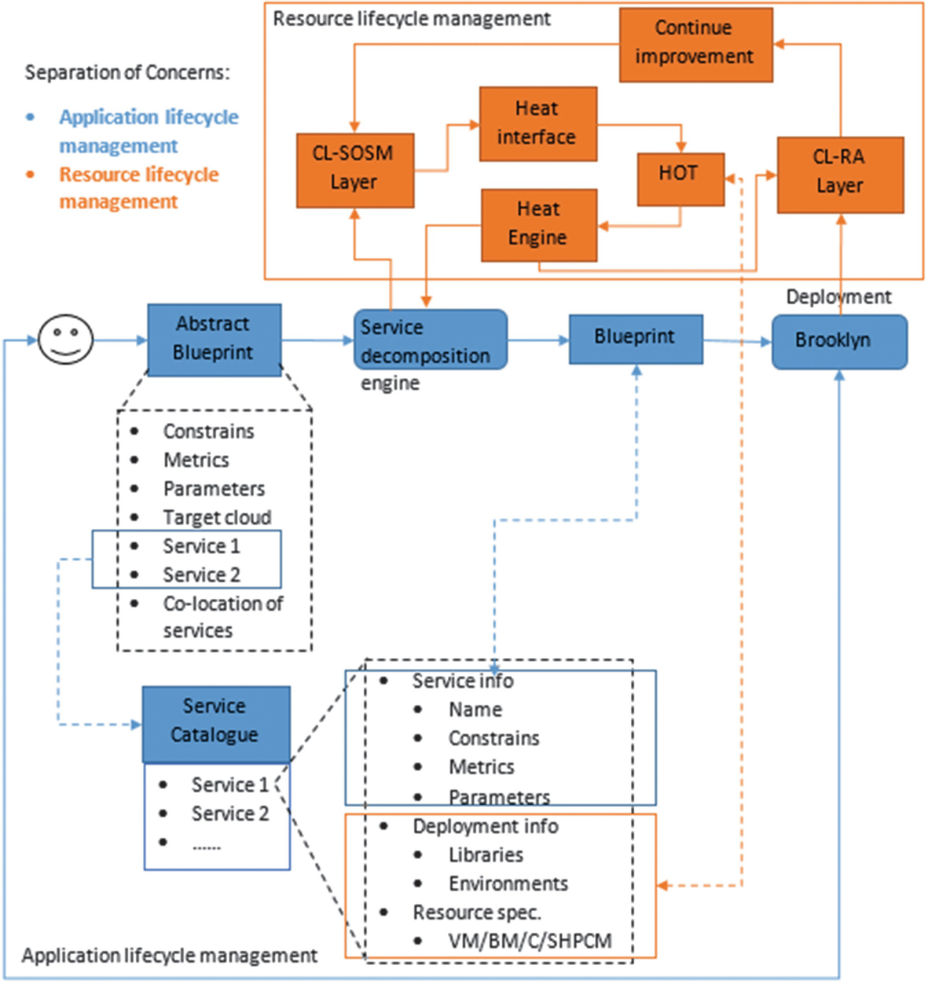
What to put in the project model?
Components of Project Model
(for Application Based):
Application Blueprint and Service Description (if needed)
Application Details
Home Page Interface
Special Icon Interface
Application Requirements
User Requirement
Software Requirement

Slide 15
What to put in the project model?
Components of Project Model (for Machine - Application Based):
Blueprint of the Project
Application Blueprint and Service Description (if needed)
Product Details
Application Details
Complete Specifications
Application Requirement

Slide 16
Project Mechanism/ Source Code

Slide 17
What to put in the project mechanism?
This part is simply the following (For Machine Based):
Step by step process on how to create the product.
Step by step process on how the product works:
Circuit Mechanism
Machine Mechanism
System Mechanism
This part is simply the following (For Application Based):
Step by step process on how to create the application.
Step by step process on how the application works:
Source Code (If already available)
Application Mechanism
System Mechanism

Slide 18
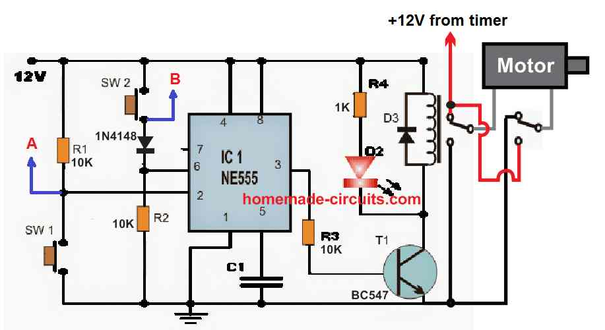
What to put in the project mechanism?
Circuit Mechanism:

Slide 19
Project Manual

Slide 20
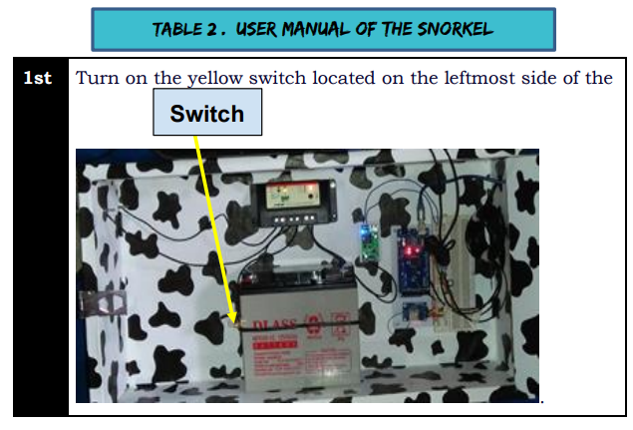
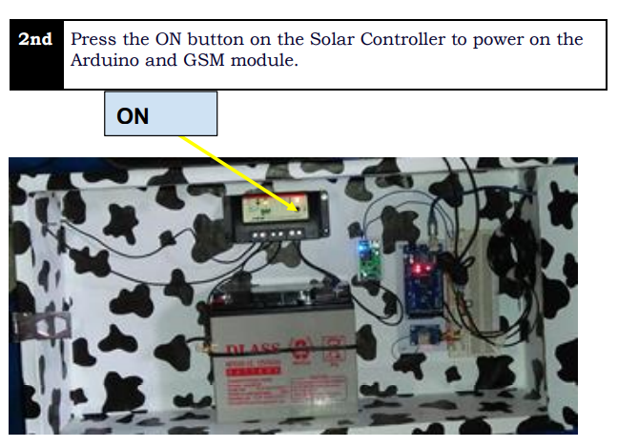
What to put in the project manual?
The user manual must show the step by step process on how to use the product. It must entail the totality of the user-friendliness through instructions that are clear and understandable. To give a light to this process, an example of a capstone project user manual of Corey (2019) is shown below.

Slide 21
What to put in the project manual?
If the manual is too creative, it can be summarized on the paper and it can be attached an appendix.

Slide 22
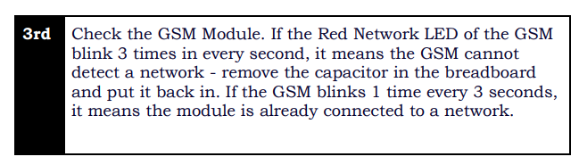
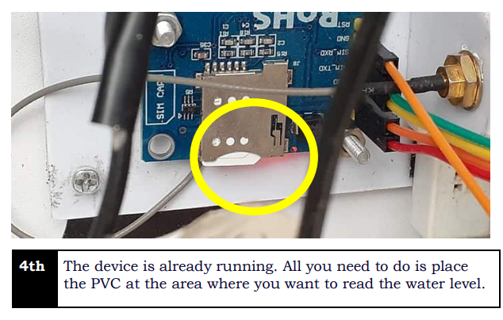
What to put in the project manual?

Slide 23
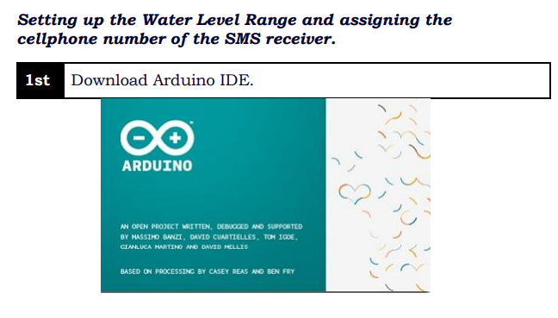
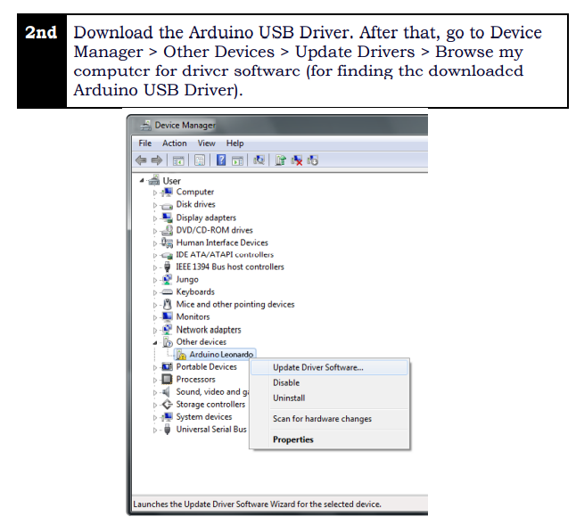
What to put in the project manual?

Slide 24
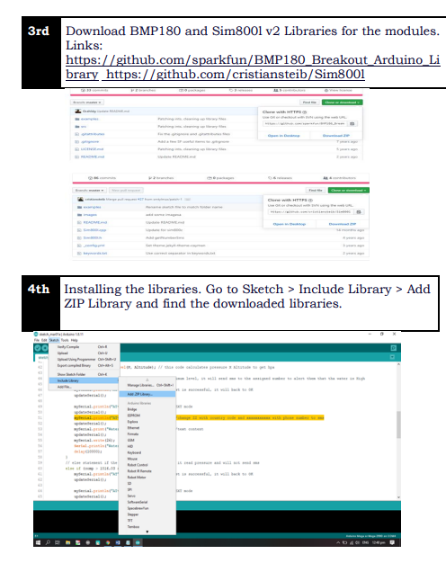
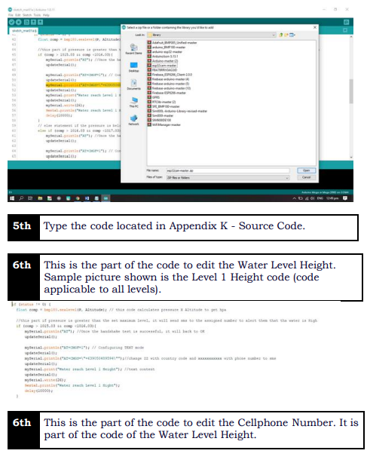
What to put in the project manual?

Slide 25
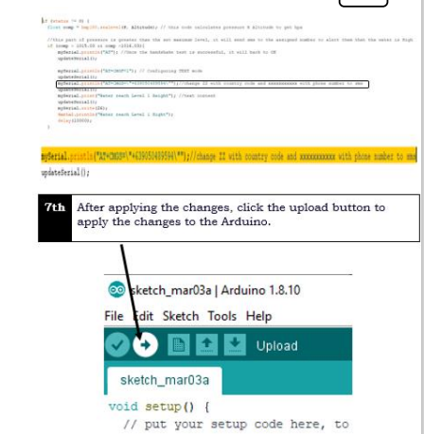
What to put in the project manual?

Slide 26
Project COST

Slide 27
What to put in the project cost?
The project cost must have the following sub-components:
Actual/Projected Cost of the Product
Project Cost Analysis
The Actual/Projected Cost of the Product should be presented through a table with all the price of the material specification on the Project Design. A paragraph that will explain the table follows.

Slide 28
What to put in the project cost?
The Project Cost Analysis is to determine the value of a project's costs and benefits, which highlights if a project is feasible.
If possible, compare the cost of your project to the other existing products set on your RL or RS.

Slide 29
VIDEO SIMULATION on the defense

Slide 30
Chap 1 -4 Presentation Circuit Mechanism Simulation Machine/Application Mechanism Simulation
Video Presentation:

Slide 31

MAY 9 – 20, 2022
CAPSTONE FINAL DEFENSE:

